Slide 1

Planning a survival analysis study … and data management issues
Steve Simon for
Notes:
Analyzing Repeated Measures Data Workshop: Module 5 The Linear Mixed Model
Copyright 2011 The Analysis Factor http://TheAnalysisFactor.com
1

Slide 2
Abstract
Lecture 3.
Planning and data management issues for survival data. Planning a study with a survival outcome requires you to specify both the number of patients and the duration of follow-up time. You’ll compute power for hypothetical studies and compare power across different research designs. Then you’ll review the data management needs of a survival study, with a special emphasis on the problems associated with date variables.

Slide 3
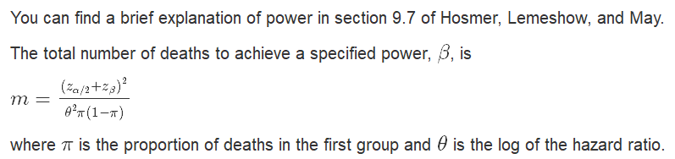
Selecting an appropriate sample size
Formula for number of deaths

Slide 4
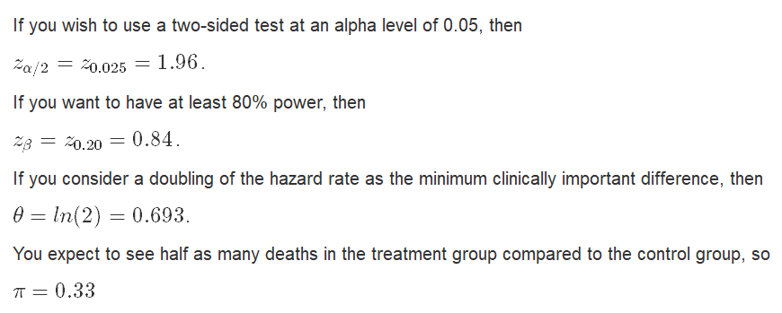
Selecting an appropriate sample size
Example of calculation

Slide 5
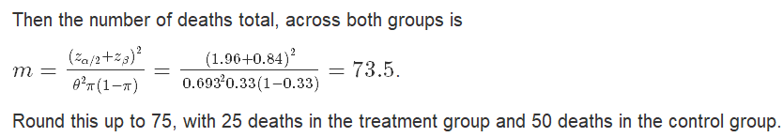
Selecting an appropriate sample size
Example of calculation

Slide 6
Selecting an appropriate sample size
Example of calculation

Slide 7
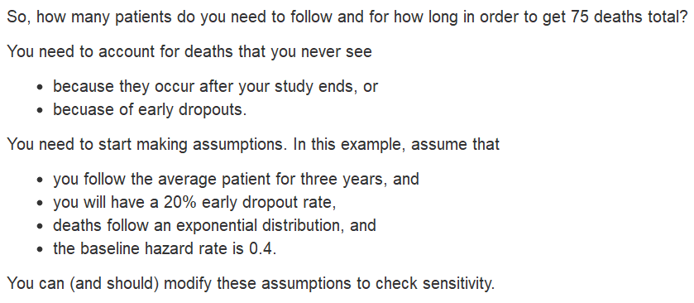
Selecting an appropriate sample size
You’re not done yet!

Slide 8
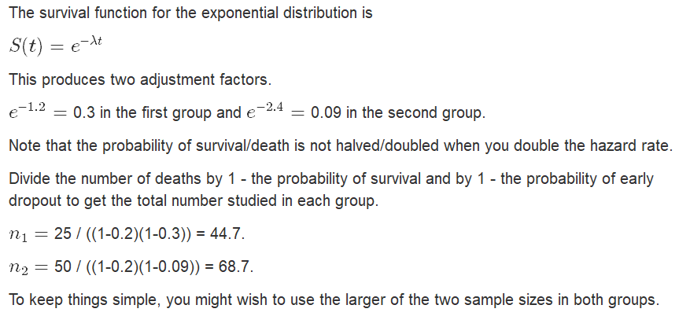
Selecting an appropriate sample size
You’re not done yet!

Slide 9
Selecting an appropriate sample size
What does a hazard ratio of 2.0 really mean?
The hazard ratio is difficult to interpret for two reasons:
It is a unitless quantity.
It is a relative measure.
It involves rates rather than probabilities.
You should see how a hazard ratio of 2.0 changes the median survival or the probability that you survive beyond a target time point.

Slide 10
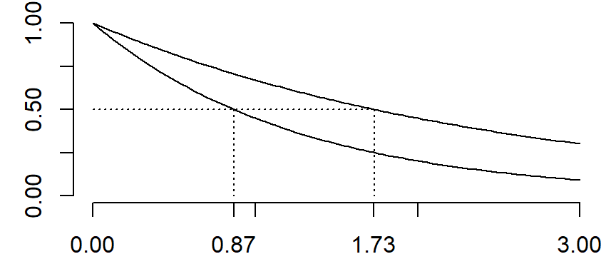
Selecting an appropriate sample size
Ten extra months for the median survival time.

Slide 11
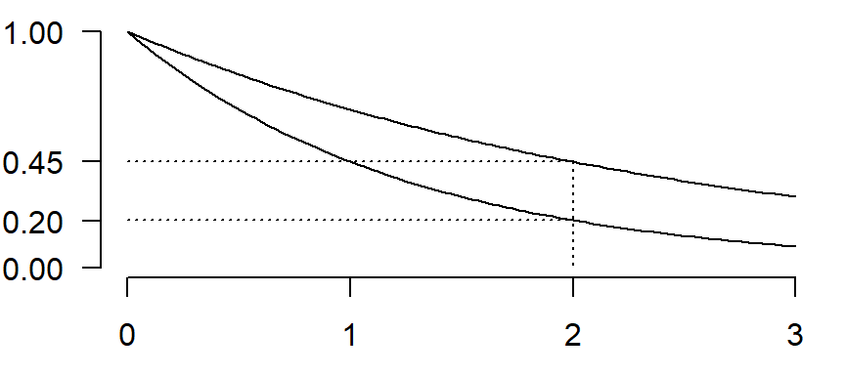
Selecting an appropriate sample size
25% greater chance of surviving to two years.

Slide 12
Selecting an appropriate sample size
Simulation of power
Many researchers consider a formula for sample size to be inadequate. The reasons include
The simplistic adjustments for censoring and dropouts.
The tendency for the sample size and power formulas to become unwieldy for even minor complications.
The inability to examine the sensitivity of your assumptions.
Simulation of power is fairly easy and very flexible.

Slide 13
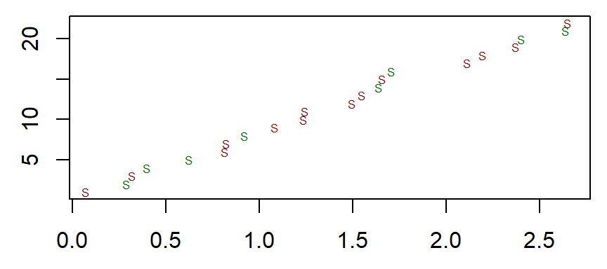
Selecting an appropriate sample size
Generate random starting times

Slide 14
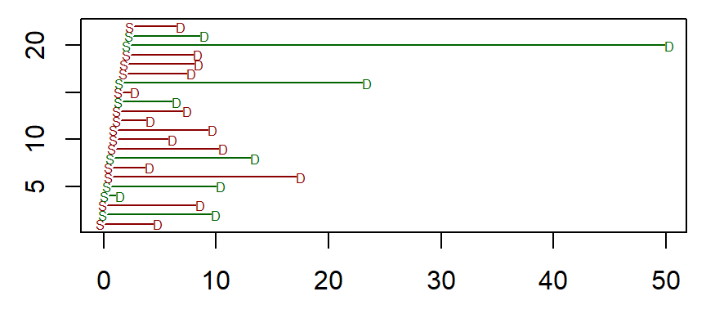
Selecting an appropriate sample size
Generate random deaths

Slide 15
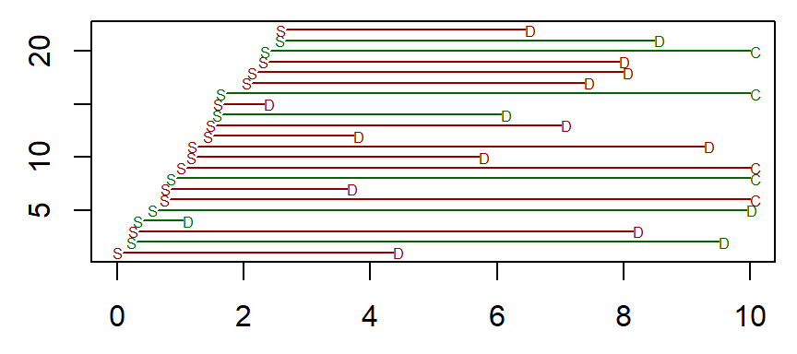
Selecting an appropriate sample size
Truncate the study at a maximum study duration time.

Slide 16
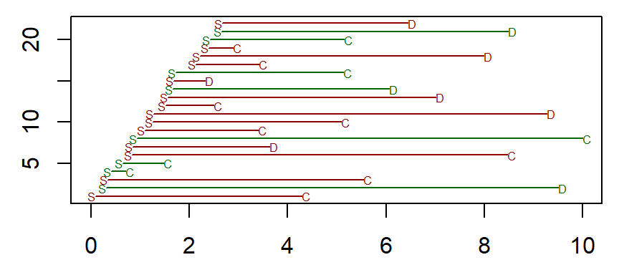
Selecting an appropriate sample size
Simulate a random process for early dropouts.

Slide 17
Selecting an appropriate sample size
Repeat 1,000 times.
Calculate the test statistic. Repeat 1,000 times. The proportion of test statistics that reject the null hypothesis is your power.
Consider sensitivity analyses. How much does your power/sample size change as you change some of the underlying assumptions.

Slide 18
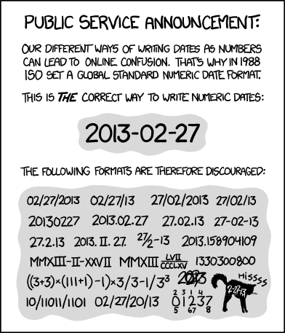

Slide 19
Data management
Internal storage of dates.
Every software program stores dates a little bit differently. R stores dates as internally as the number of days since January 1, 1970.
baseline <- as.Date("1/1/1970", format="%m/%d/%Y")
print(baseline)
## [1] "1970-01-01"
print(as.numeric(baseline))
## [1] 0

Slide 20
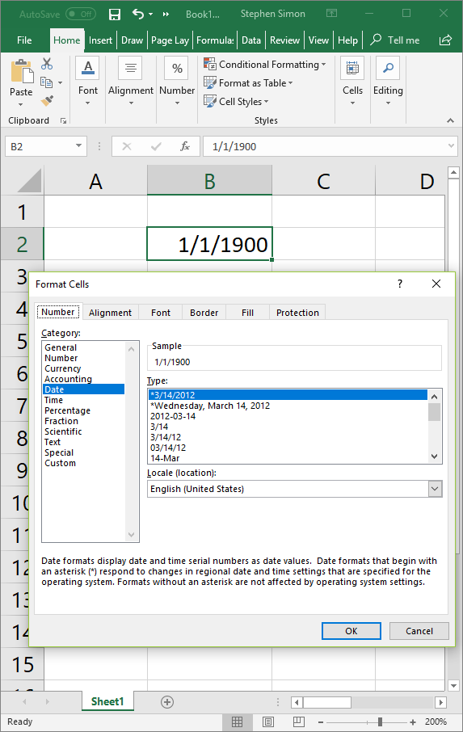
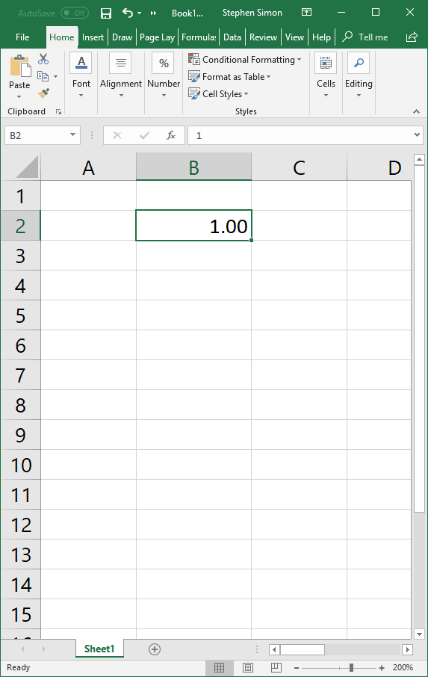

Slide 21
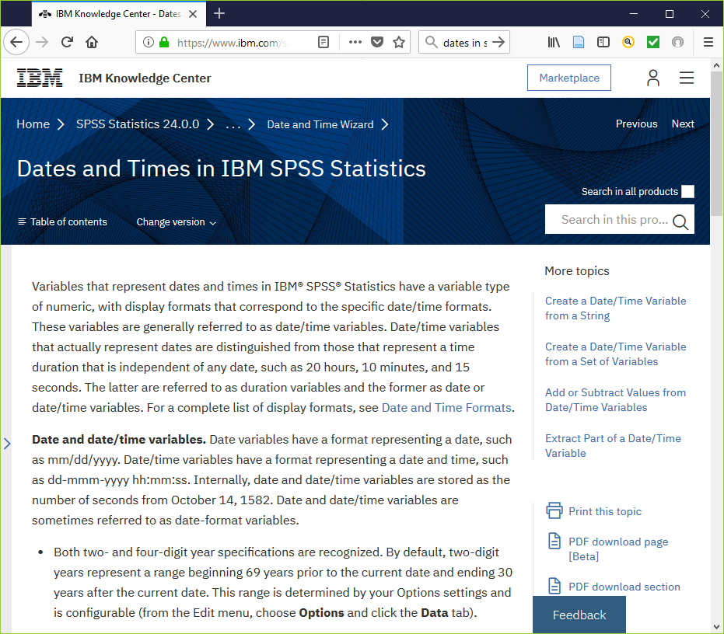

Slide 22
Data management
Importing dates
Every software package is different, but in general when you import dates from another program, you will get
a date stored in the correct internal format.
a date stored in incorrectly.
a string that looks like a date but cannot be used in calculating time intervals.
a number related to the internal storage format of the system you are importing from.

Slide 23
Data management
Importing dates
If you are entering the data yourself,
always specify year with four digits, and
use a consistent pre-defined format.
ISO 8601 format (yyyy-mm-dd) is best for two reasons
It sorts well, even if stored as a string.
It is different from both the informal American (mm-dd-yyyy) and the European (dd-mm-yyyy) standards.

Slide 24
Data management
Importing dates
If your data imports incorrectly,
check for the wrong century,
check for origin problems (e.g., 1960-01-01 versus 1970-01-01),
try a more rigid or structured format for the import, or
fix things by hand.
Always document your choices.

Slide 25
Data management
Manipulating dates
The computer software does not wants time intervals, not dates.
The time interval is usually just the subtraction of two dates.
Use built-in functions if you can.
Know your units of conversion
86,400 seconds in a day,
30.4375 days in a month,
365.25 days in a year.

Slide 26
Data management
The three dates you need
If you are given a data set where the censoring time is given for you, great! If you have to figure out the censoring time, you need at least three dates.
the date of origin,
the date of the event (if it occurred),
the date of last contact with the patient.

Slide 27
Data management
The date of origin
The date of origin seems like it should be easy, but it is not. It could be
the date of birth,
the date of diagnosis,
the date of randomization,
the date when therapy was first initiated.

Slide 28
Data management
The date of origin
For particular events, the date of origin might change.
Rehospitalization, use date of first discharge.
Failure of a mechanical device, use date of implant.
Divorce, use date of marriage.
Loan default, use date of loan contract.
Infectious disease, use date of first exposure.

Slide 29
Data management
The date of event
The date of the event is dependent on how you define the event.
All-cause mortality versus mortality related to the health condition.
Composite endpoints (death or relapse) require comparing the earlier of two dates.
If the event did NOT happen, leave this field blank/missing.

Slide 30
Data management
The date of last contact
Every patient will have a date of last contact. It will be the last time that you have been able to contact the patient and confirm that the event has not yet occurred.
If the event has occurred, you have several reasonable choices:
put the event date in this field also,
leave the field blank/missing,
put the last date of contact,
(a date after the event date may represent a data error!)

Slide 31
Research design issues.
Prospective analyses
Compared to most other studies, a prospective survival analysis
takes a lot more time,
requires more intensive follow-up, and
suffers more from dropouts.
You should plan for aggressive follow-up and/or rely on outside sources to ascertain why someone dropped out of the study.
You should collect and manage data longitudinally.

Slide 32
Research design issues.
Interim analysis
Interim analyses look at early stopping for
vastly superior efficacy,
vastly worse side effects, or
futility.
Question: How do you handle patients with very little follow-up time at an interim analysis?
Answer: surrogate outcomes

Slide 33
Research design issues.
Retrospective analyses
Retrospective studies are almost always
faster,
cheaper, but
require a longitudinal data source.
You can often supplement with data from an external sources (e.g., National Death Index).

Slide 34
Research design issues.
Survival analysis is an alternative to “intention to treat”
Intention to treat analysis (ITT) provides special handling of patients who
discontinue the assigned therapy, or
switch to the competing therapy.
Survival analysis with time-varying covariates provides an interesting alternative to ITT.

Slide 35
Conclusion
What have you learned today?
The initial sample size calculations are in terms of the number of events.
You have to extrapolate with parametric assumptions to get the number of patients and the required follow-up time.
Data management requires special attention to dates.
Survival models raises difficult, but interesting research design issues.

